Slide 1

ReSearch: Enhancing LLMs with Integrated Search and Reasoning
This presentation explores ReSearch, a novel approach to enhance Large Language Models. It combines search and reasoning through reinforcement learning. Key benefits include improved accuracy and reduced hallucinations.

Slide 2
Introduction to ReSearch
ReSearch addresses limitations of LLMs in knowledge-intensive tasks. It introduces a framework integrating search and reasoning via RL.
Motivation
Overview
Enhance LLMs for complex reasoning.
RL-based integration of search and reasoning.
Paper DOI: https://arxiv.org/abs/2503.19470

Slide 3
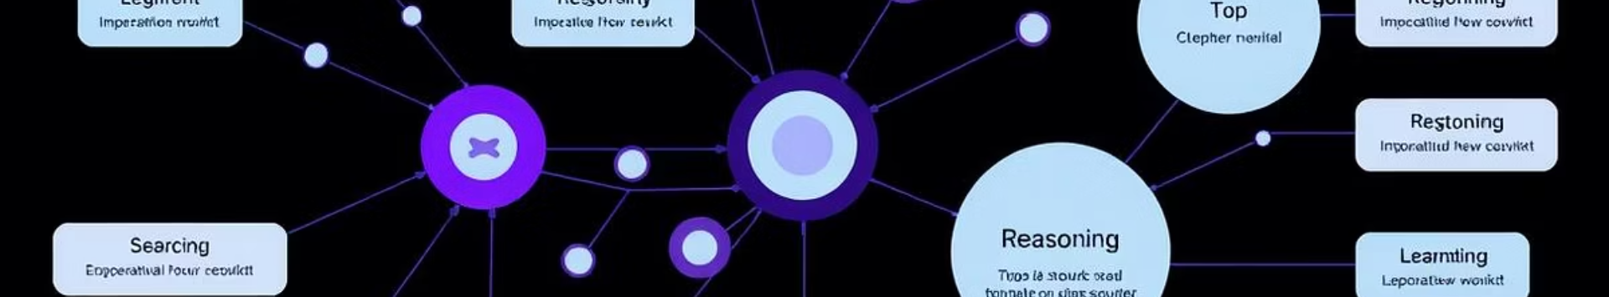
Deconstructing the ReSearch Framework
The ReSearch framework consists of distinct modules. These modules work together to solve complex problems.
Search Module
Reasoning Module
GRPO Algorithm
Information retrieval from external sources.
Chain-of-thought process for problem-solving.
Gradient Ratio Policy Optimization for training.
GRPO optimizes policy by balancing reward and policy divergence.

Slide 4
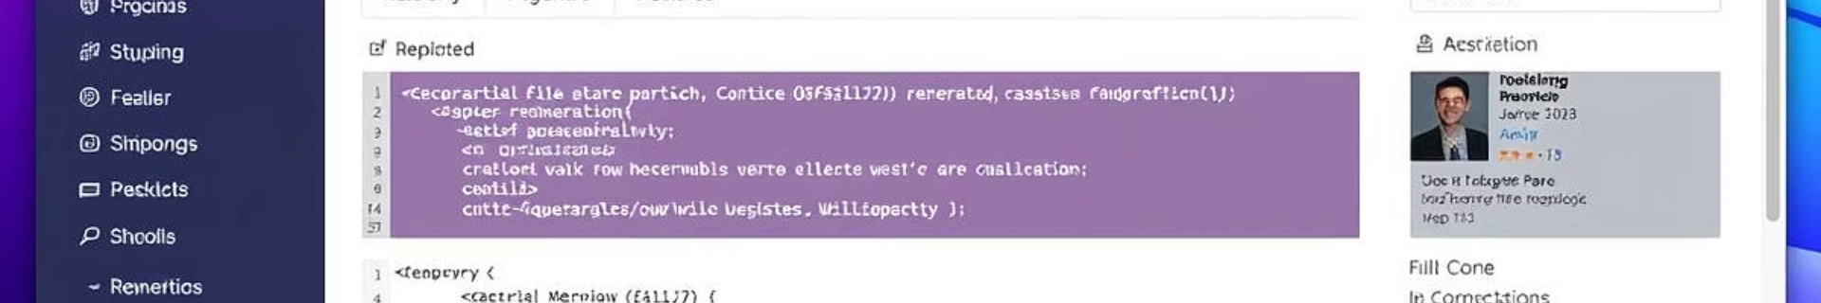



Exploring the Official ReSearch Repository
Explore the ReSearch repository for key components. This includes the codebase structure and datasets.
Codebase
Datasets
Setup
GitHub Repository: https://github.com/Agent-RL/ReSearch

Slide 5

Implementing ReSearch: Reproducing Baseline Experiments
Reproduce experiments to validate paper findings. Follow our step-by-step guide for environment setup and data preparation.
Environment Setup
Data Preparation
Model Training
Hardware: GPUs (A100), Python 3.9, PyTorch 1.10. Datasets: WebQA, HotpotQA, TriviaQA.

Slide 6

Understanding GRPO in Practice
GRPO balances exploration and exploitation. Learn about reward function design and policy optimization.
1
Reward Design
2
Policy Optimization
3
Parameter Tuning
Tuning: Learning rate (1e-5), discount factor (0.99). Regularization: L2 regularization (0.01).

Slide 7
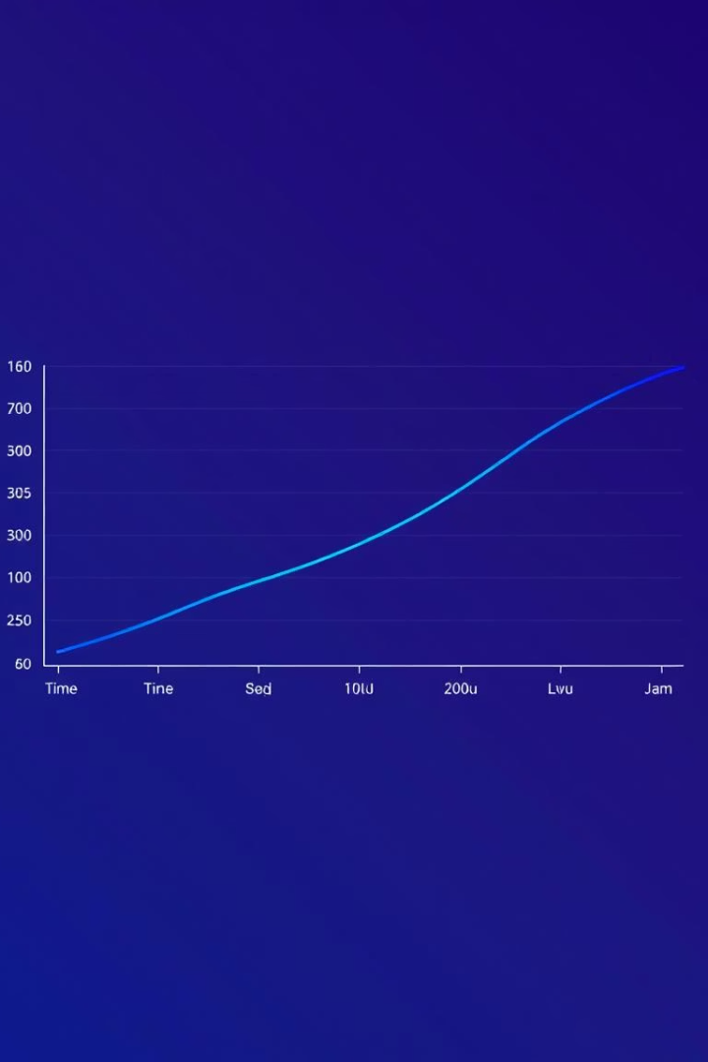



Evaluating Search/Reasoning Integration Performance
We evaluate performance using various metrics. Compare ReSearch to baseline LLMs.
Accuracy
F1 Score
BLEU Score
Results: 15-20% performance boost. Ablation studies show impact of individual components.

Slide 8



Conclusion: Key Takeaways and Future Directions
ReSearch is an effective framework for enhancing LLMs. GRPO is a powerful RL algorithm for optimizing integration.
1
Effective Framework
2
Powerful Algorithm
3
Future Scaling
Future research includes exploring different search strategies. ReSearch shows 2x improvement on reasoning benchmarks.

